Slide 1

PHP – An Introduction

Slide 2
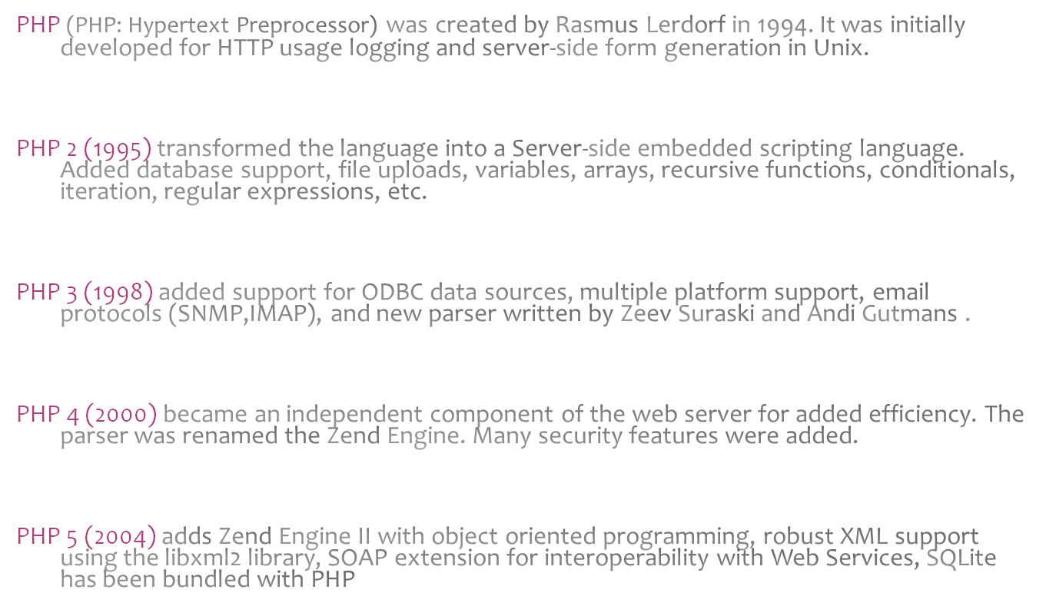
Brief History of PHP

Slide 3
Why is PHP used?
Easy to Use
Code is embedded into HTML. The PHP code is enclosed in special start and end tags that allow you to jump into and out of "PHP mode".
<html>
<head>
<title>Example</title>
</head>
<body>
<?php
echo "Hi, I'm a PHP script!";
?>
</body>
</html>

Slide 4
Why is PHP used?
Cross Platform
Runs on almost any Web server on several operating systems.
One of the strongest features is the wide range of supported databases
Web Servers: Apache, Microsoft IIS, Caudium, Netscape Enterprise Server
Operating Systems: UNIX (HP-UX, OpenBSD, Solaris, Linux), Mac OSX, Windows NT/98/2000/XP/2003
Supported Databases: Adabas D, dBase,Empress, FilePro (read-only), Hyperwave, IBM DB2, Informix, Ingres, InterBase, FrontBase, mSQL, Direct MS-SQL, MySQL, ODBC, Oracle (OCI7 and OCI8), Ovrimos, PostgreSQL, SQLite, Solid, Sybase, Velocis, Unix dbm

Slide 5
Why is PHP used?
Cost Benefits
PHP is free. Open source code means that the entire PHP community will contribute towards bug fixes. There are several add-on technologies (libraries) for PHP that are also free.
 | PHP
Software | Free
Platform | Free (Linux)
Development Tools | Free PHP Coder, jEdit

Slide 6
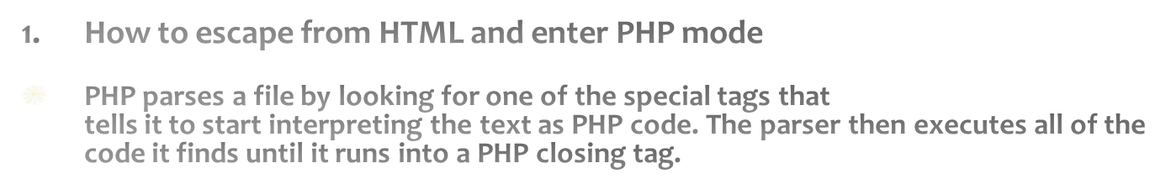
Getting Started
HTML
PHP CODE
HTML
<?php echo “Hello World”; ?>
Starting tag | Ending tag | Notes
<?php | ?> | Preferred method as it allows the use of PHP with XHTML
<? | ?> | Not recommended. Easier to type, but has to be enabled and may conflict with XML
<script language="php"> | ?> | Always available, best if used when FrontPage is the HTML editor
<% | %> | Not recommended. ASP tags support was added in 3.0.4

Slide 7

Getting Started
<html><head> <title>My First PHP Page</title> </head> <body> <?php echo "Hello World!"; ?> </body></html>
Copy the code onto your web server and save it as “test.php”.
You should see “Hello World!” displayed.
Notice that the semicolon is used at the end of each line of PHP code to signify a line break. Like HTML, PHP ignores whitespace
between lines of code. (An HTML equivalent is <BR>)

Slide 8
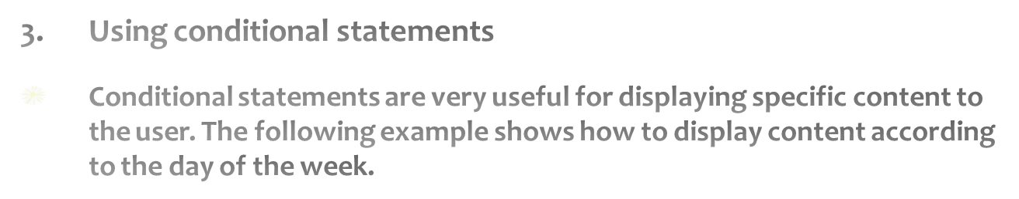
Getting Started
<?php $today_dayofweek = date(“w”); if ($today_dayofweek == 4){ echo “Today is Thursday!”; } else{ echo “Today is not Thursday.”; } ?>

Slide 9
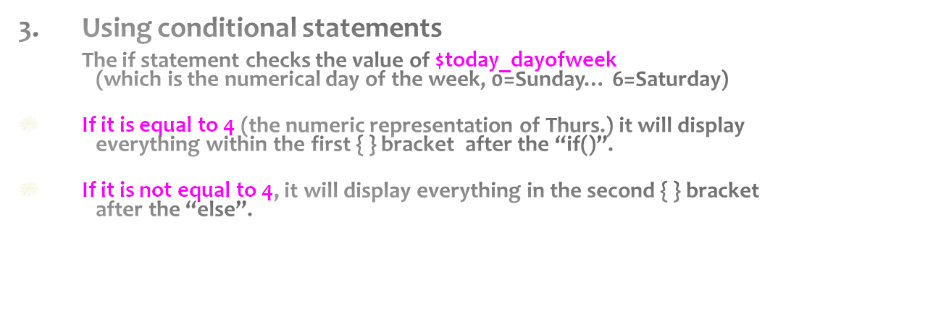
Getting Started
<?php $today_dayofweek = date(“w”); if ($today_dayofweek == 4){ echo “Today is Thursday!”; } else{ echo “Today is not Thursday.”; } ?>

Slide 10
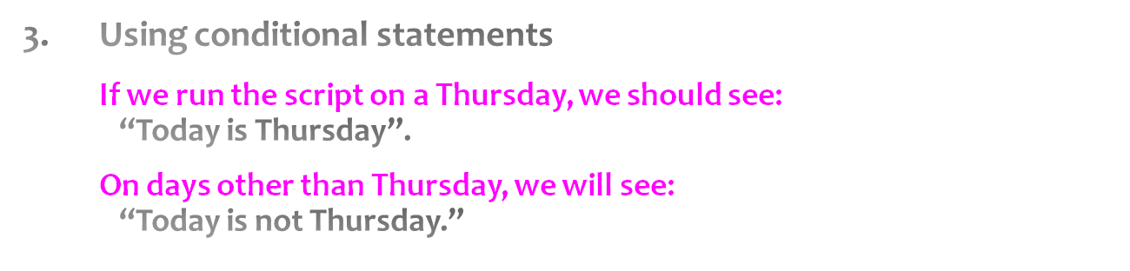
Getting Started
<?php $today_dayofweek = date(“w”); if ($today_dayofweek == 4){ echo “Today is Thursday!”; } else{ echo “Today is not Thursday.”; } ?>

Slide 11
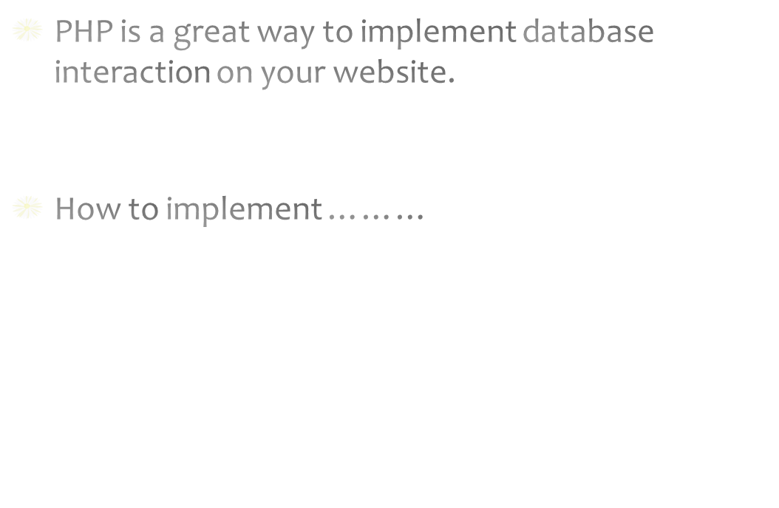
Examples

